Slide 1

Restaurant Health Inspection Data Analysis
Analyst: Jason Thompson
Notes:
Hello and welcome! My name is Jason Thompson.
Today we will be exploring restaurant health inspection data in order to see if there is a correlation between health inspection scores and the population of the area in which the restaurant is located.
We will begin by introducing the areas we’re going to cover throughout this presentation.
With that said, let’s get into it!

Slide 2
Areas of Focus
Data Question and Sources
Hypotheses and Data Limitations
Top 10 Violations
Distribution of Violations per Restaurant
Arrangement of Population Densities and Zip
Median Violation Amounts
Inspection Scores and Population by Zip
Average Scores by Month
Conclusion/Key takeaways
Questions/Discussion
Notes:
We’ll start off with directing our focus toward the data question we hope to answer and the sources used in attempting to answer it..
From there, we’ll discuss some hypotheses about the scenario we’re exploring and some limitations encountered in exploring the data.
From there we’ll look at the top ten violations that occur in two cities.
From there we will look at how the violations per restaurant are distributed, the arrangement of population densities by zip codes into groups, all to arrive at the median violation amounts for each group.
Toward the end we’ll look at inspection scores and population by zip code, average scores by month, and conclude with some key takeaways that this analysis has made available to us and close with opening the floor up for questions or discussion. We’ll now move on to the next slide for our data question and sources.

Slide 3
Data Question and Sources
Is there any correlation between restaurant health inspection scores and the population of the areas in which they are located?
Anchorage, AK: 291,563
San Francisco, CA: 1,259,145
Restaurant and Food Inspections: City of Anchorage
Restaurant Scores - LIVES Standard (San Francisco)
US Zip Codes Database
Notes:
The data question we will be exploring: Is there any correlation between restaurant health inspection scores and the population of the areas in which they are located?
To answer this, I’ve chosen two US cities differing drastically in population: Anchorage, AK: 291,563 and San Francisco, CA: 1,259,145. Next are the links to the datasets used for this analysis along with a population-by-zip-code dataset that I’ve joined to each city’s data.
We continue to our next slide where we look at some hypotheses along with some data limitations that were encountered.

Slide 4
Hypotheses and Data Limitations
Hypotheses
Higher populations means more customers
More customers can mean neglect
Neglect means lower scores
Inspectors can be too lenient or too strict
Violations can vary in point deduction amounts
Limitations
Analysis is based of 2016-2019
Some zip codes for both cities lacked population density
Notes:
Our hypotheses:
Restaurants in more heavily populated areas receive more customers than those lightly populated
With restaurants in more heavily populated areas, restaurant staff could be tempted to allow customer satisfaction to take priority over duties related to strong health inspection scores
If health inspection duties are neglected, the establishment stands to receive a lower score, especially in the event of a surprise inspection
Health Department inspectors can have a varying level of leniency about what they count against a particular restaurant establishment
Lastly, individual violations can vary in point deduction amounts, so just because an establishment may have more violations, that doesn’t necessarily mean that their score will be lower than other restaurants that have less violations.
Now for our Data Limitations
While the Anchorage dataset has data for years 2000 - 2019, the San Francisco dataset only covers 2016-2019. Since these are the years the datasets have in common, these are the only years the analysis is performed.
Some zip codes in both datasets do not have corresponding population densities recorded for them and since population is a key factor in our hypotheses, those zip codes were not included in the analysis.
We’ll now move forward to view our first visual on top ten violations for these two cities.

Slide 5
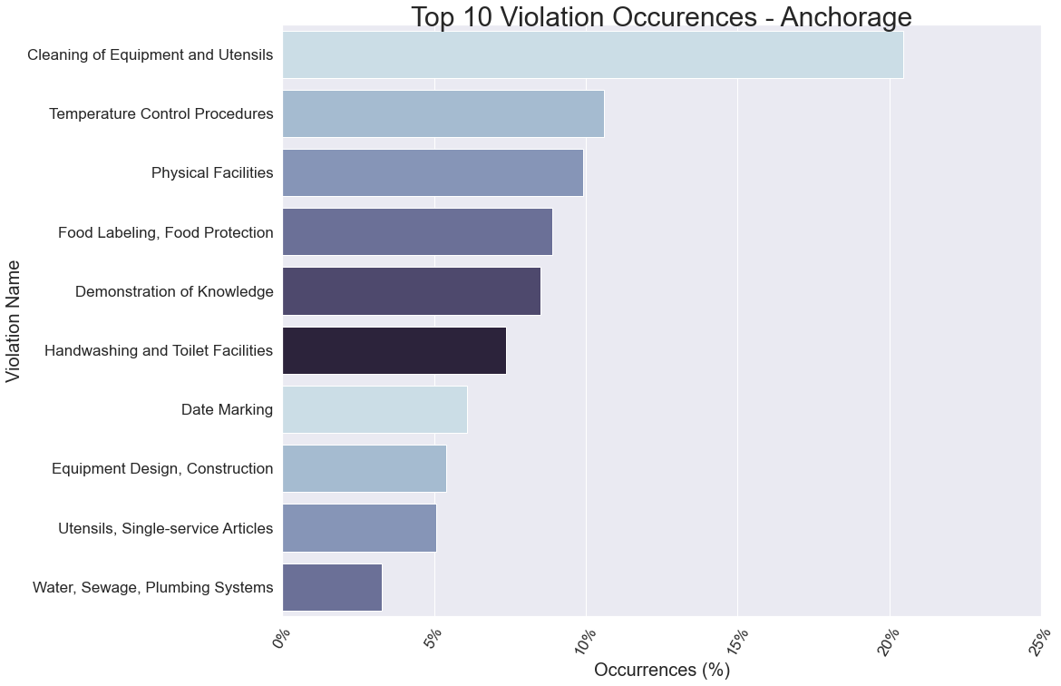
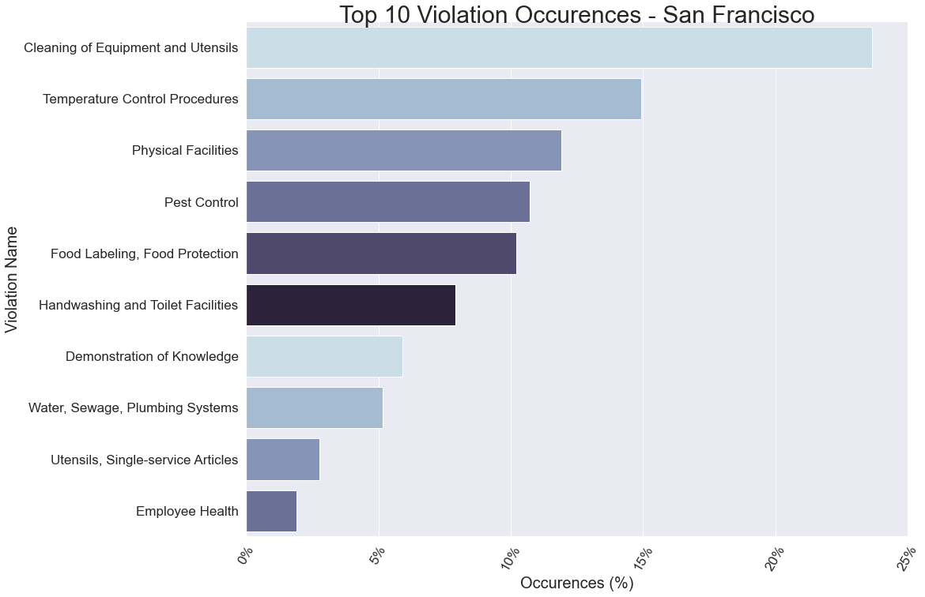
The two cities have many violations in common
Only four violations not in common between them
Number one violation: Cleaning of equipment and utensils
Number two violation: Temperature control procedures
Number three violation: Physical Facilities
Notes:
Here we see two visuals pointing out which violations each city has from a larger to smaller scale. The percentages along the x-axis are how much of the whole each violation makes up of all violations for that city.
In viewing this we can clearly see how these two cities have a lot of violation types in common. In fact the only items they do not have in common are Food date marking, faulty equipments design/construction, pest control issues, and matters having to do with employee health. We also see that the number one violation type in both cities is the proper cleaning of equipment and utensils. Secondly, temperature control procedures for food, thirdly, items involving the facility itself and so on.
We’ve seen which violation types each city has in common and those that rank the highest, but how does population come into play? In the next few slides we will explore just that.

Slide 6
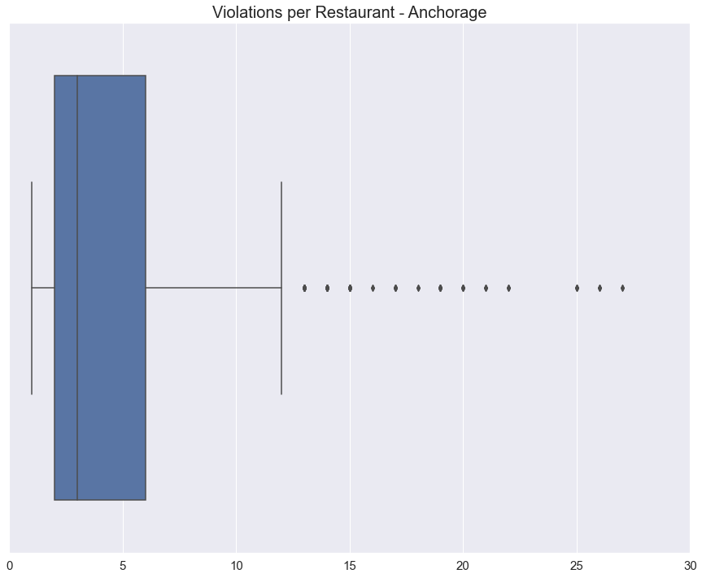
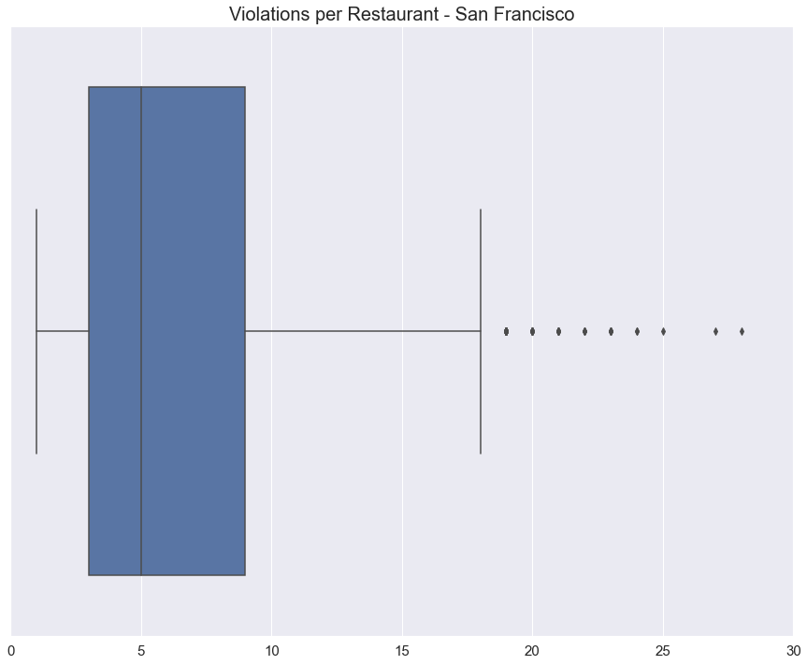
Used to view the number of outliers
If there are many, calculate for median
If there are few, calculate for the mean
Outliers represented by dots beyond the ‘T’
Many outliers, calculate for the median
Notes:
Before you are two box and whisker plots.
Each represents the count of violations per restaurant for each city.
These were created to see how many outliers were present in our counts.
Part of the end goal is to get the amount of violations per restaurant while also bringing in population density for the zip codes where the restaurant is located.
In order to accomplish this, we must first determine whether we need to use a mean or median calculation.
If there aren’t enough outliers to skew the mean, then we calculate for the mean, but if there are, we calculate for the median.
The dots beyond the whisker, which looks like a ‘T’ represent our outliers.
Our conclusion is that we have many outliers for both cities so we will calculate for the median number of violations per restaurant location.
We’ll now move forward to develop this.

Slide 7
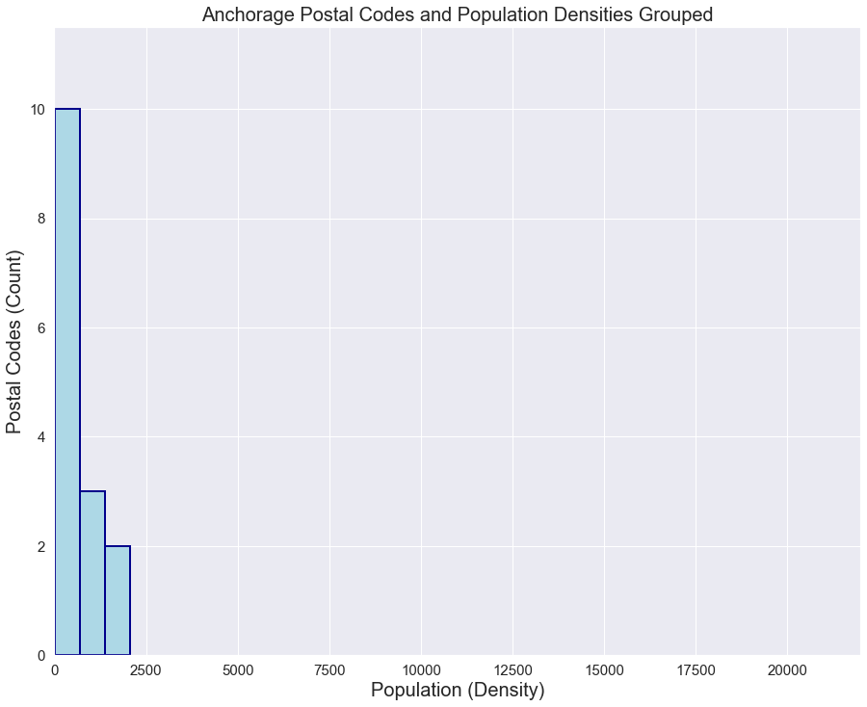
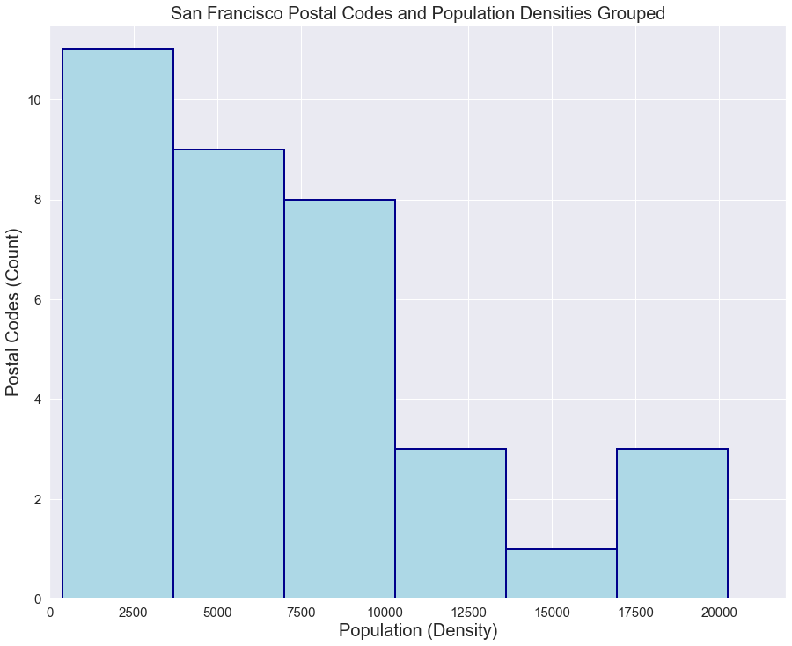
Densities by Zip into groups
Done to determine the appropriate amount of groups
Notes:
Our next step is take our population densities by zip code amounts and place them into buckets.
The two histograms in the slide represent our population density amounts (x-axis) per zip code amounts (y-axis) for a ‘high-medium-low’ concept for our population densities.
We do this to get an idea of how many groups we need to sort our zip codes in based on related population density amounts.
For example, based on the histogram on the left for Anchorage, we have a density of about 688 for 10 zip codes as the cut off for our first group. For the San Francisco histogram on the right, we have a density that’s a little less than 2,750 for 11 zip codes for the cutoff for our first group.
We’ll now move on to our result of our median calculation for violations per restaurant.

Slide 8
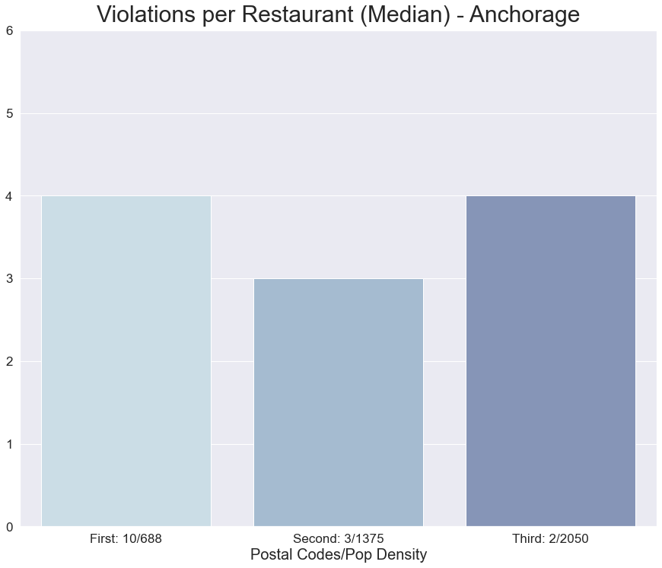
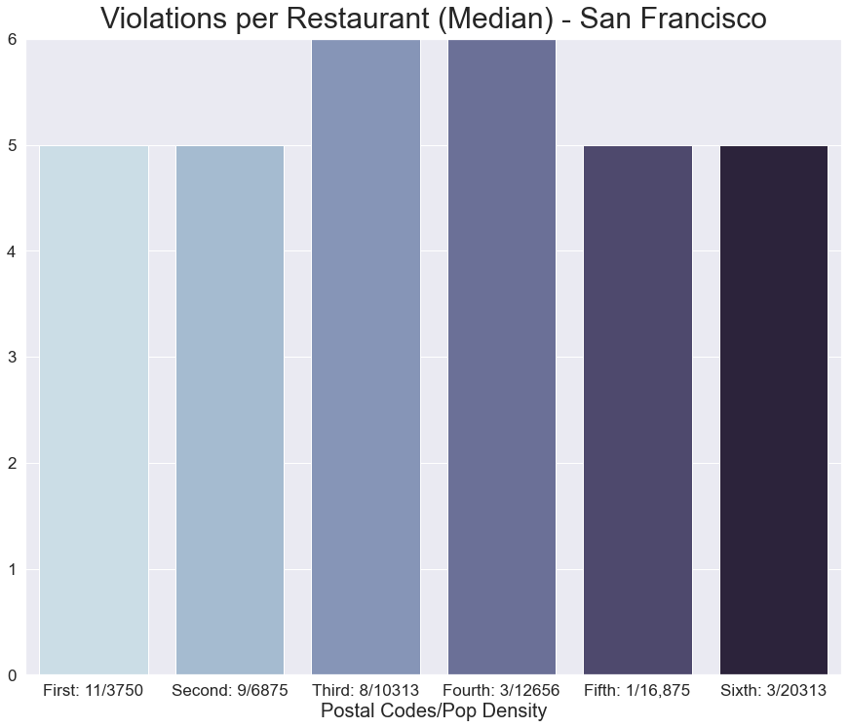
Groups represented by bars from histograms
Overall median higher in San Francisco than Anchorage
Contributes to confirmation of our hypothesis
Does more violations mean a lower inspection score?
Notes:
After calculating the median for each group for each city, this is our result.
You can see that each of the bars represent our groups from the histograms on the previous slide.
We see that on the x-axis of the Anchorage column chart, we have our three groups listed with our first group consisting of 10 zips codes and a density of 688.
Our first group for San Francisco has 11 zip codes with a density of 3750, and so on.
Our result reveals that the overall median amount of violations per restaurant is higher in San Francisco with Anchorage having no more than four and San Francisco have no less than 5.
Within each city we have some up and down on violation medians in areas that have higher and lower populations, but again with looking at the overall comparison, San Francisco comes out on top with more.
This metric clearly contributes to answering our data question.
However, as was mentioned in our hypotheses, just because you have more violations does that necessarily constitute a lower health inspection score? After all, is each violation point deduction the same as all others? That being said, we consider our next slides.

Slide 9
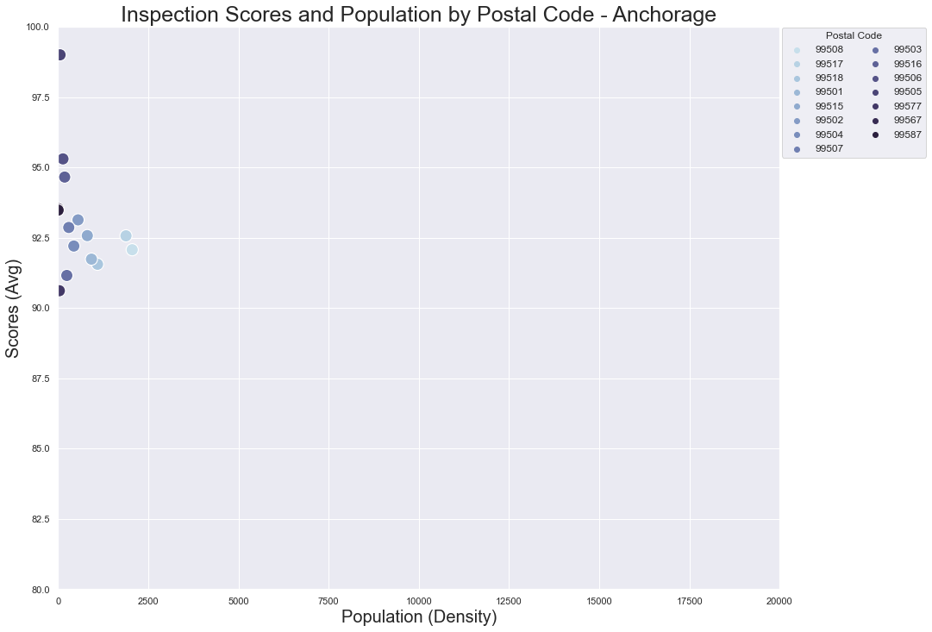
Scores do drop in more densely populated areas
Score do get any lower than 90
Notes:
Before you is a scatter plot representing the overall average scores for varying population densities broken up by the same zip codes.
These figures pertain to Anchorage.
In viewing this, we can see that some scores do tend to drop when in more densely populated zip codes within the city to the exception of a few, but we also notice that scores for Anchorage don’t really fall below 90.
Let’s move forward to compare these observations with San Francisco in the next slide, where we have applied the same method.

Slide 10
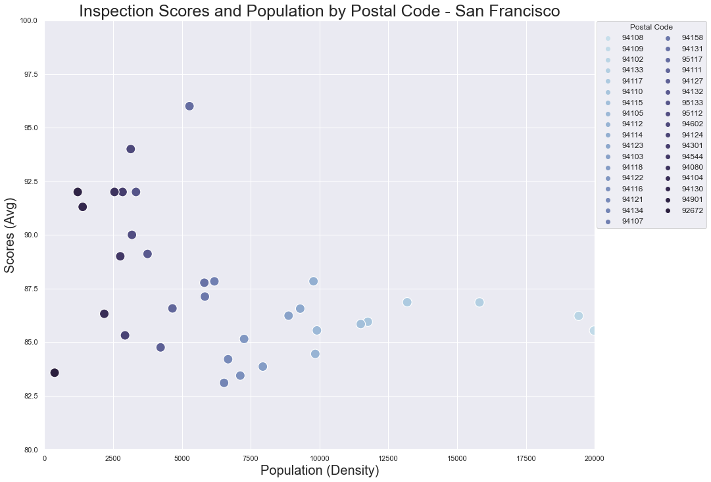
San Francisco also has decline in scores as density increases
Scores are mostly below 90
More violations = lower scores
Notes:
In viewing this slide we see that Anchorage and San Francisco have one thing in common: they both have decline in average scores as more heavily populated zip codes are considered.
However, while the scores in Anchorage don’t get below 90, the majority of scores for San Francisco are below 90.
Let me remind you also that the median amount of violations for San Francisco was a higher number than Anchorage as well. This being said, while we may not know exactly how many points any one violation may cost someone, it appears that more violations does equal lower scores, if there are enough.
I would like to note that this plot and the one on the previous slide are not normalized based on the number of restaurants in each city or each zip code. For that reason, the averages could be skewed, which would prevent us from making a more definite conclusion. Despite that, these plots are still an indicator of some note of lower scores per higher population density because both charts show a downward trend when considering higher numbers of population density.
We’ll now move forward to our final visualization for the presentation.

Slide 11
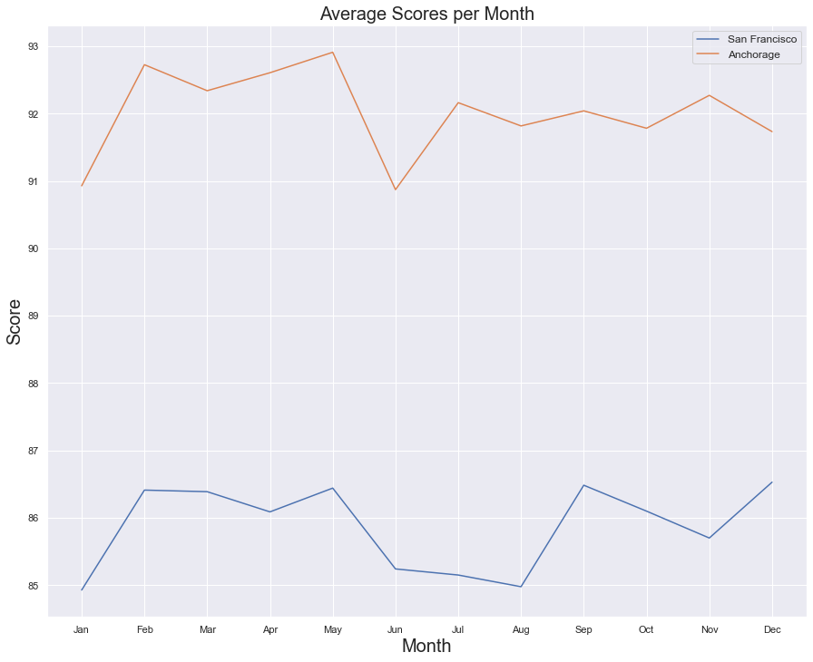
Another example of higher scores in Anchorage
Decline in scores for summer months, April, November
Increase of people in the area can sway scores
Notes:
Here, we consider the average score for each month across 2016 through 2019 for each city.
This is another situation where we can see that Anchorage’s scores are higher overall than San Francisco’s.
One very obvious observation that can be made is the slight decline in scores around the summer months for both cities, which is a strong vacation season.
We also see slight declines in the months of April and November.
April probably has to do with weather warming back up thus everyone is ready to get back out into the world and November probably has to do with traveling for the Thanksgiving season.
On that note, while vacationing and holidays are not an increase in population, it is a surge in number of people to the area that can sway the scores. It appears in this visual that it does.
Once again, I would like to note that this plot is not normalized based on the number of restaurants, but the differences in scores between the two cities are large enough for our point to be valid.

Slide 12
Conclusion/Key Takeaways
Cities have two of the top three violations in common:
Cleanliness of Equipment and Utensils
Physical Facilities
Population does appear to have significant effect on both cities.
Unexpected info: Seasonal Influxes
Notes:
Here we conclude with some key takeaways from our analysis.
Two of the top three violations that occur in restaurants in both of these cities have to do with cleanliness of the equipment used in holding and handling food and the cleanliness and disrepair of the physical facility. These two areas aren’t directly tied to serving the customer. This is a possible indicator of more focus going toward it and not so much toward areas not directly related to it.
While there may be many factors that can contribute to more violations and lower health inspection scores for restaurants, we see that population does appear to have effect on both of them.
While we didn’t expect it, we also notice that along with population, seasonal influxes of people to an area also has an effect to these items.

Slide 13
Questions and Discussion?
Notes:
We have reached the end of our presentation! Please feel free to ask any questions or bring up any topics for discussion you may have concerning the presentation. I appreciate your kind attention!

